Slide 1
ICARUS Solar Panel Irradiance Meter
Brandon Thompson
University of Washington, Bothell
Industrial Group, Fluke Park

Slide 2

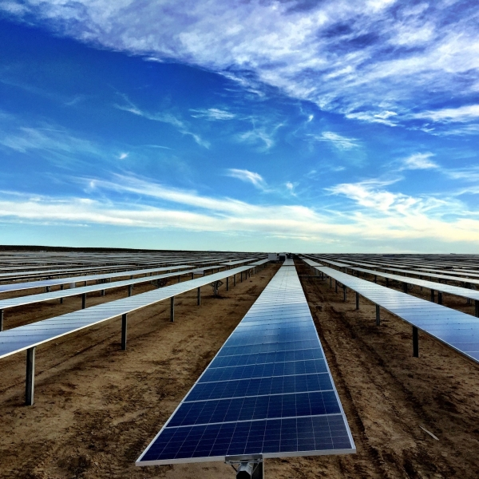
Summer Objectives
Become familiar with the definition and the uses of irradiance in the solar panel industry
Determine how irradiance (W / m²) is calculated, and which sensors are needed
Consider what factors can affect the irradiance calculation, and mitigate the effects
Build a working prototype as a proof of concept, seeking to match a competitor’s finished product

Slide 3
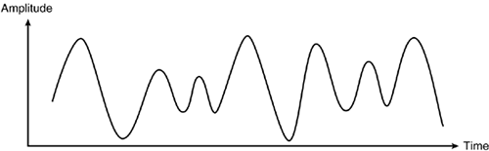
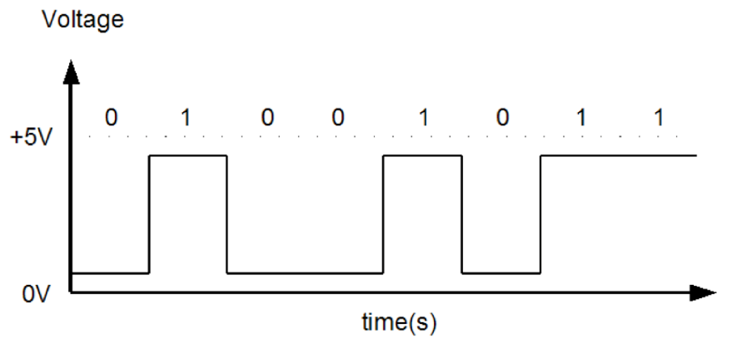
Research Phase
To calculate irradiance, the voltage from the solar cell is used.
To account for reduced efficiency, we read the temperature of the cell and altered the effective irradiance
ANALOG SIGNAL PINS
Solar reference cell
Thermistor on back of cell
Ambient temperature sensor
DIGITAL SIGNAL PINS
3 input buttons for displays and functions
I²C for accelerometer acting as an inclinometer
SPI for LCD display
SECONDARY OBJECTIVES
SPI for thermocouple module to read external temperatures
UART for Bluetooth module

Slide 4
Assembling Phase
Tested/Assembled in order of importance
Initializing microprocessor and running “Hello World”
Modifying LCD library file and interfacing LCD with microprocessor
Interfacing solar cell and outputting voltage reading
Interfacing and outputting thermistor temperature
Interfacing and outputting temperature sensor
Modifying accelerometer library file, and interfacing with microprocessor

Slide 5
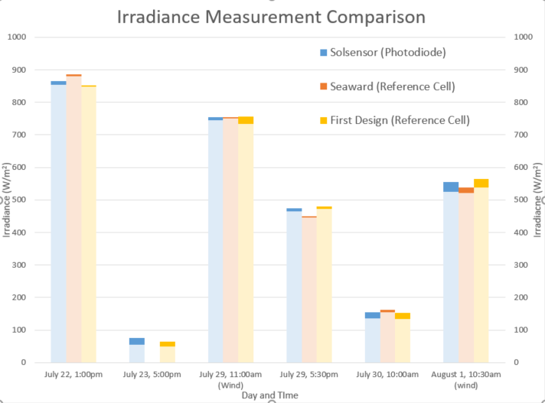
Final Data Compilation
Icarus was compared with a reference tool, the Solsensor, and a competitor’s product, the Seaward.
Icarus was closer to the reference than Seaward
The larger data swing in the Icarus design is from the combination of noise from the voltage gain, and the effects of wind on the un-protected thermistor

Slide 6
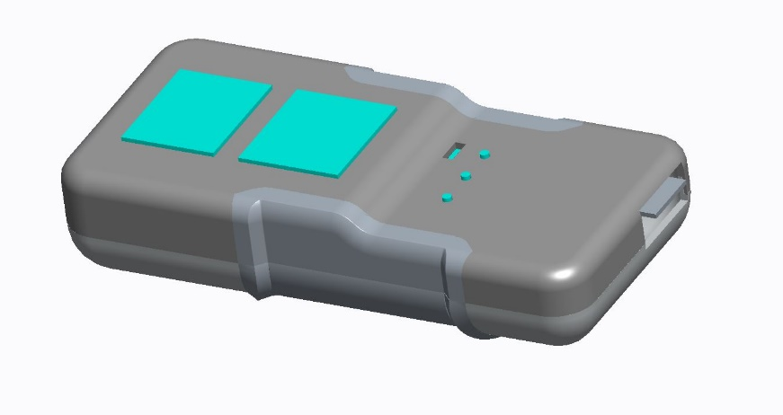
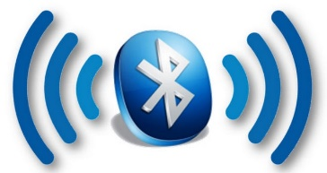
Future Steps for Enhancements
Two improvements have been made to further stabilize and enhance sensor measurement accuracy and precision
A 3D printed case has been made to reduce
the effects of wind
A low-pass filter (simple moving average) was implemented to smooth the data and reduce the effects of noise
A Bluetooth low energy module to communicate and transmit data
Calibrating the solar cell with the 1000 W/m² solar standard in a lab

Slide 7
Summer Learnings
Saving code and code-revisions using Git and Github
Designing and printing PCB’s using in-house resources
Developing firmware for embedded systems and sensors
Using software filters of various kinds to minimize the effects of noise on data
The basics of Bluetooth low energy programming and processor integration
Comparisons between Bluetooth v5 and the previous version of Bluetooth
Developing code for the Nordic modules and software suites
Learned soldering

Slide 8
Feedback
This internship has been the highlight of the summer, and I’ve been eager to get to work each day
Positives:
Prototyping from the ground-up
Working on a project that has meaning
Operating on an independent basis
Interdisciplinary work, and fostering a sense of the importance of communication
Fantastic coworkers and mentors, all willing to help and give advice
A hands-off mentorship, without micromanaging
Positive work environment
Ideas for Consideration:
Perhaps a bit more involvement with tools and processes used in industry
Overall, this internship has been better than I could have hoped, especially in comparison with a previous internship. I am very happy with the people and teammates I have worked with, and the knowledge I have gained from this process

